Slide 1
History of the Guitar Famous Players & Styles

Slide 2
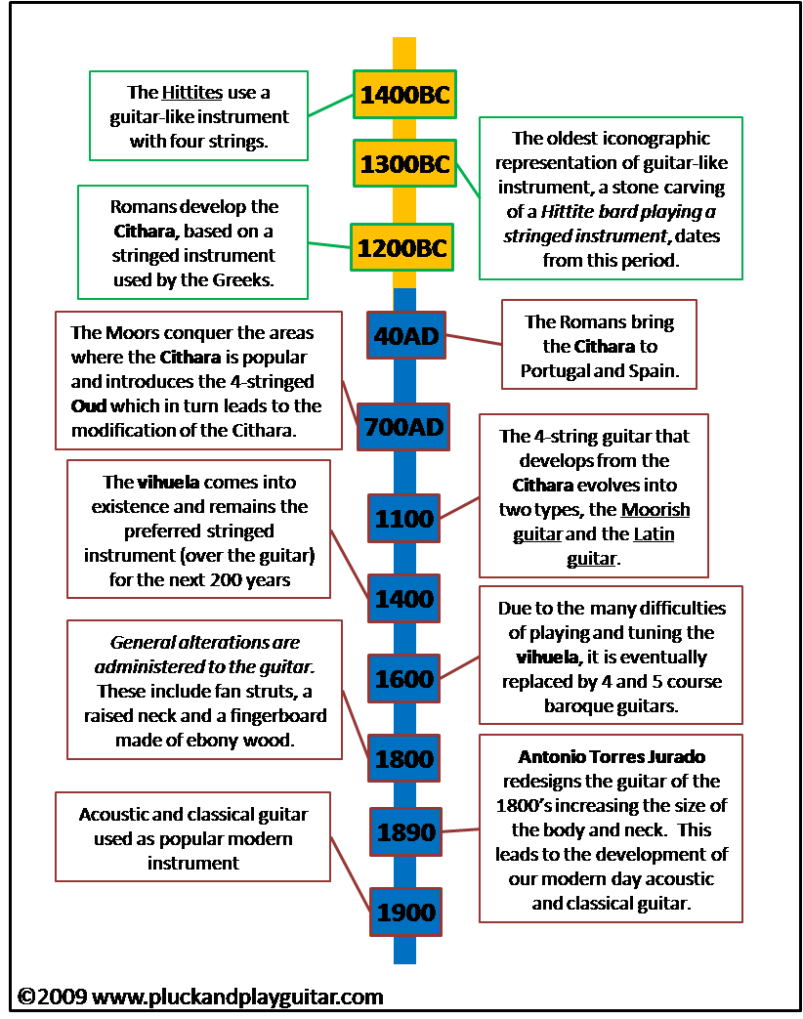
History of the Guitar

Slide 3
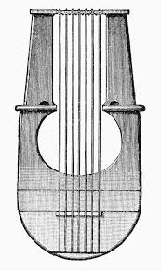
Cithara
# 1200 BC
# Developed by the Romans, but used by the Greeks
# 7 strings
# 40 AD – Romans bring to Spain
# The Moores conquer areas where the Cithara is popular and modify it…

Slide 4
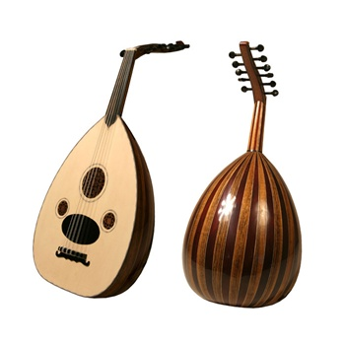
Oud
700 AD
Modification of the
Cithara (one step up!)
# Now has 4 strings

Slide 5
Cithara vs Oud What are similarities and differences?

Slide 6
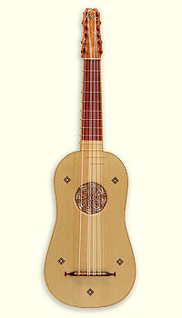
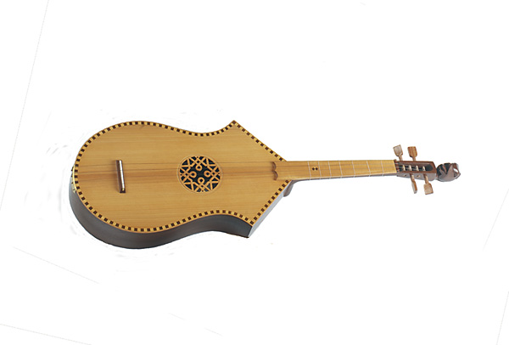
Moorish and Latin Guitars
# The oud develops into the Moorish and Latin guitars in 1100

Slide 7
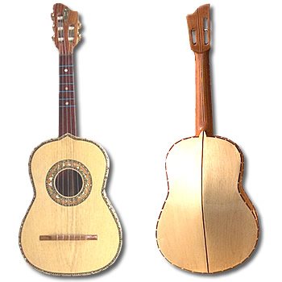
Vihuela
# Preferred string
instrument OVER the
guitar for the next
200 years!

Slide 8
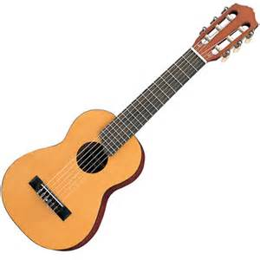
The guitar as we know it today…
# Due to difficulties playing and tuning the Vihuela, it was replaced with 4 and 5 string guitars which we still use today
# In our class, we play a six string guitar
# 1890 – redesigned body and neck by Antonia Torres Jurado (the guitar we use today)
#1900 guitars are used as a popular modern instrument

Slide 9
Can you guess who these famous guitarists are?
#Guitar Player #1
#Les Paul
#Guitar Player #2
#The Beatles
#Guitar Player #3
# BB King
Guitar Player #4
# John Mayer

Slide 10
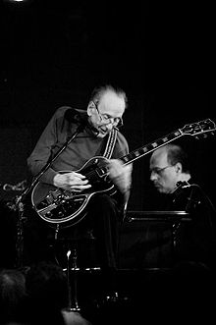
Les Paul 1950’s
Lester William Polsfuss
(June 1915-August 2009)
Jazz, country, blues genres
Pioneer of the solid body electric guitar
Overdubbing (sound on sound), delay
pedal effects
https://www.youtube.com/watch?v=HH8vjxFIUC4

Slide 11
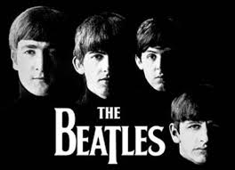
The Beatles 1960’s
1960’s
Members: John Lennon, Paul McCartney, George Harrison, Ringo Starr
Rock & pop ballads
Rolling Stone Magazine – “best artist of all time”
Known for adding non-traditional instruments to rock music
Eleanor Rigby – what instruments do you hear?

Slide 12
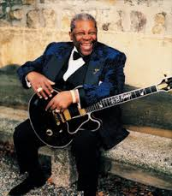
BB King 1980’s contribution…
Born 1925 (but we’re going to talk about
his contributions in the 80’s
Performed 300 nights a year!
Very special sounding voice - raspy
“When Love Comes to Town”
Jazz/Blues
U2
https://www.youtube.com/watch?v=Z8EZN9Tt9Yg

Slide 13
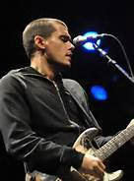
John Mayer
1977-present
Berklee College of Music!
Guess who else went there?!
Acoustic rock
Known for writing his own material
https://www.youtube.com/watch?v=WQtGqmi2O2U
What type of guitar do you see him playing in his music video?

